Slide 1


CUSTOMER Churn Prediction Capstone project
KONG WEI SHEN (DATA SCIENCE STUDENT)

Slide 2

Agenda
INTRODUCTION
PIPELINE
DATA DESCRIPTION
EXPLORATORY DATA ANALYSIS
MODEL
BUSINESS EVALUATION
SUMMARY

Slide 3

introduction
BACKGROUND
Contract/ Service termination (“churn”) is a revenue losses to company.
Customer retention is one of the primary KPI for telco company with subscription based business model.
PROBLEM STATEMENT
How to identify which are the customer who going to terminate the services ?
What are the characteristic of churning customer?

Slide 4
OBJECTIVE
Develop model to predict customer churn
Identify features which lead customer to churn.
Forecast Retaining Rate for surplus profit.
STAKEHOLDER
Marketing Manager
Product Manager

Slide 5
PIPELINE
Exploratory Data Analysis
Model Development
Featuring Engineering
Evaluation
Model
Optimization
Data Collection
Deployment
Problem Definition

Slide 6
pipeline
Data Collection
Exploratory Data Analysis
Model Development
Featuring Engineering
Evaluation
Model
Optimization
Data Cleaning
Data
Pre-processing
Heatmap
Bar Chart
Scatter Plot
Label Encoding
One Hot Encoding
Data Transformation
Logistic Regression
Support Vector Machine
K- Nearest Neighbour
Random Forest
Confusion Matrix
Recall
ROC
Hyper Parameter Tuning
Ensemble Method

Slide 7
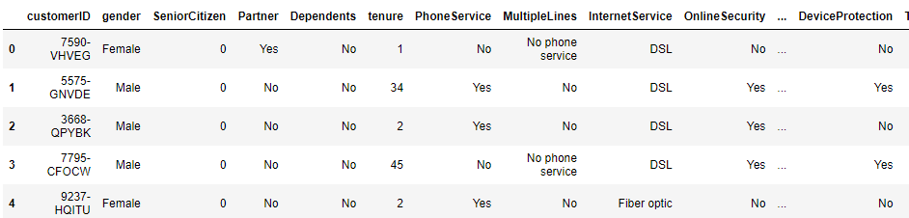
DATA DESCRIPTION
Source: (https://www.kaggle.com/blastchar/telco-customer-churn)
Shape: (7043, 21)
Null /Missing Value: NA

Slide 8
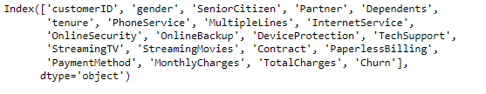
DATA DESCRIPTION
Features
Churn
Signed Up Services
Account information
Demographic Information

Slide 9
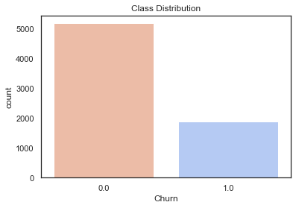
EXPLORATORY DATA ANALYSIS - TARGET
-------
------------------

Slide 10
EXPLORATORY DATA ANALYSIS - FEATURES
?
Customer ID
Gender
Stream TV
Stream Movie
Senior Citizen
Tenure
Phone Service
Multiple Line
Internet Service
Online Backup

Slide 11
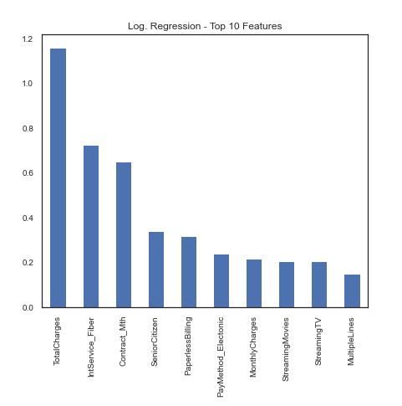
EDA - top FEATURES

Slide 12
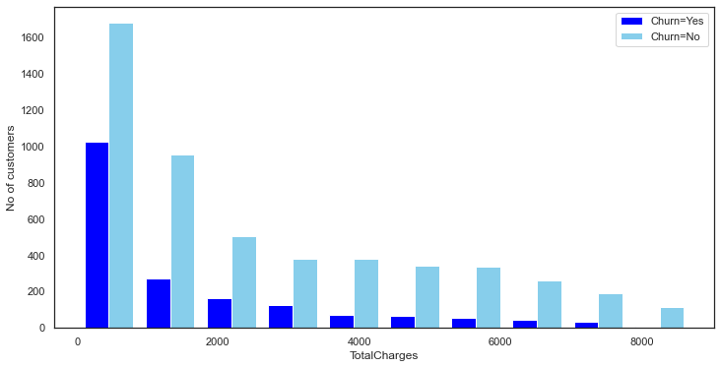
EDA- FEATURE- Total Charges

Slide 13
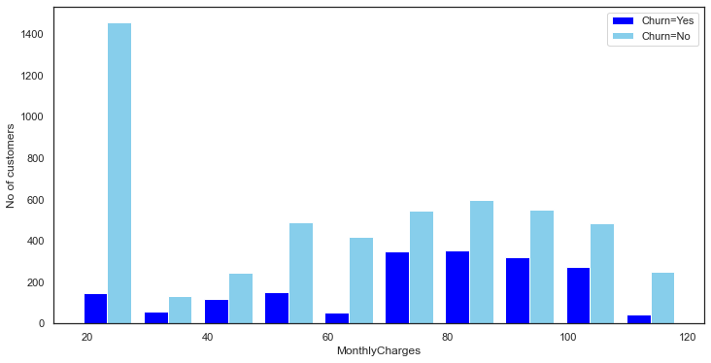
EDA- FEATURE- Monthly Charges

Slide 14
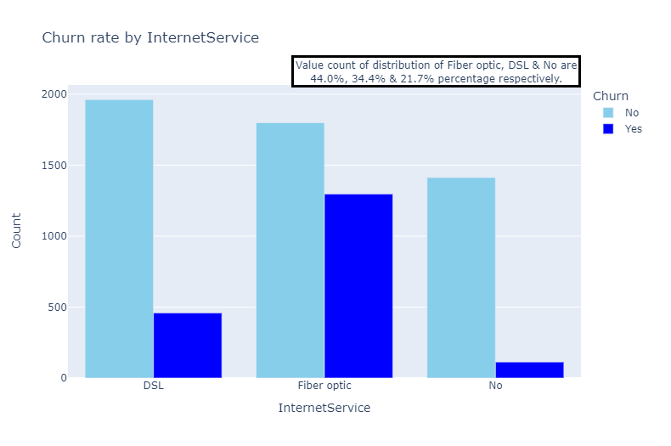
EDA- FEATURE- internet service

Slide 15
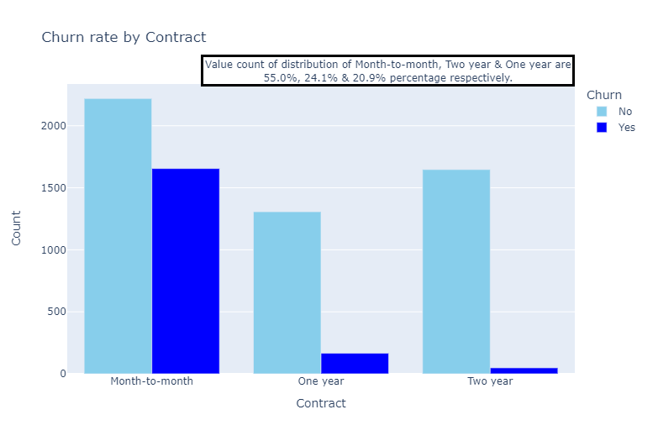
EDA- FEATURE- contract

Slide 16
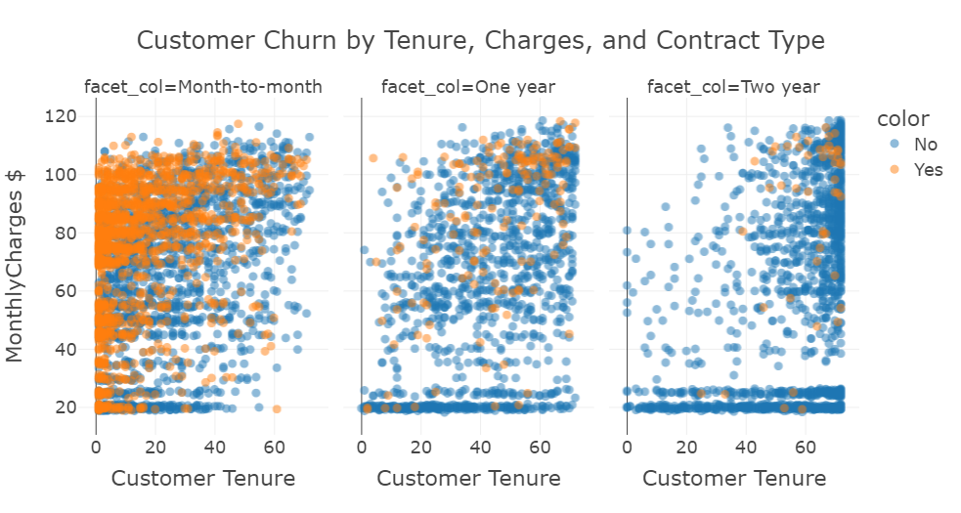
EDA- FEATURE- contract/tenure

Slide 17
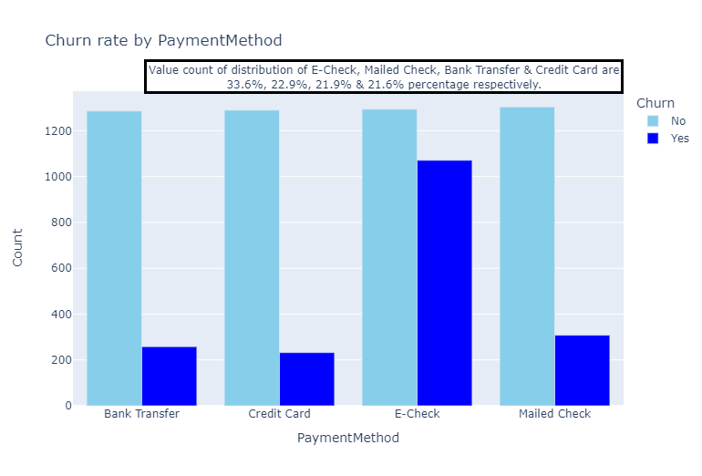
EDA- FEATURE- payment method

Slide 18
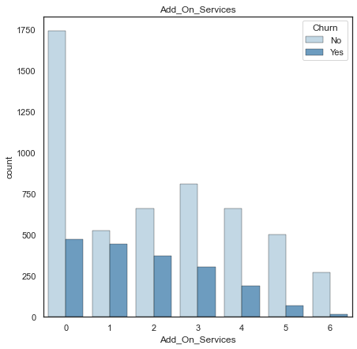
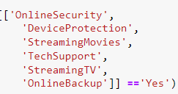
EDA- FEATURE- add on services

Slide 19
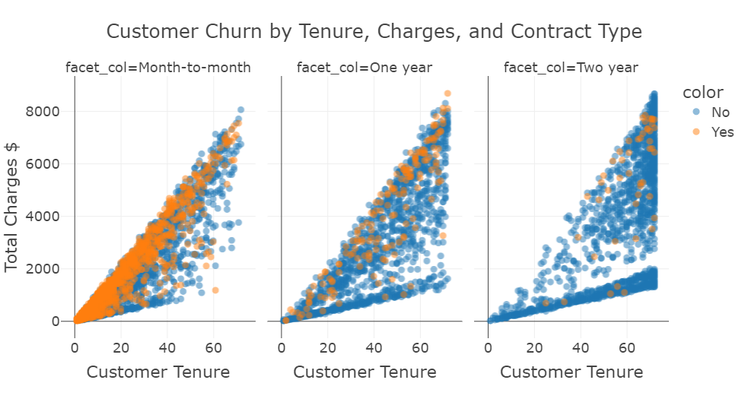
EDA-important features

Slide 20
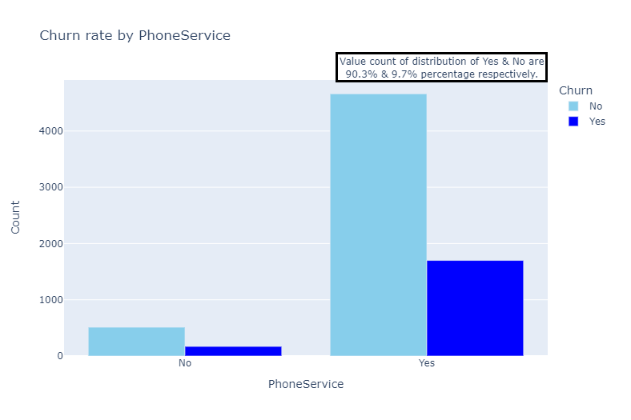
EDA-important features

Slide 21
Model - development
Model Development
Featuring Engineering
Evaluation
Model
Optimization
Label Encoding
One Hot Encoding
Data Transformation
Logistic Regression
Support Vector Machine
K- Nearest Neighbour
Random Forest
Confusion Matrix
Accuracy
F1 Score
Hyper Parameter Tuning
Ensemble Method

Slide 22
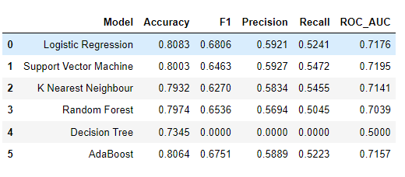
Model - evaluation

Slide 23
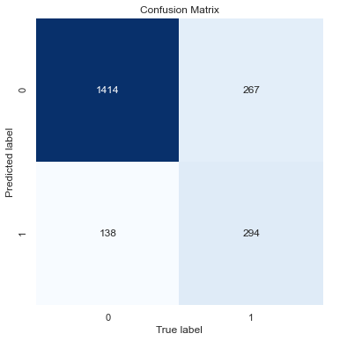
Model - evaluation

Slide 24
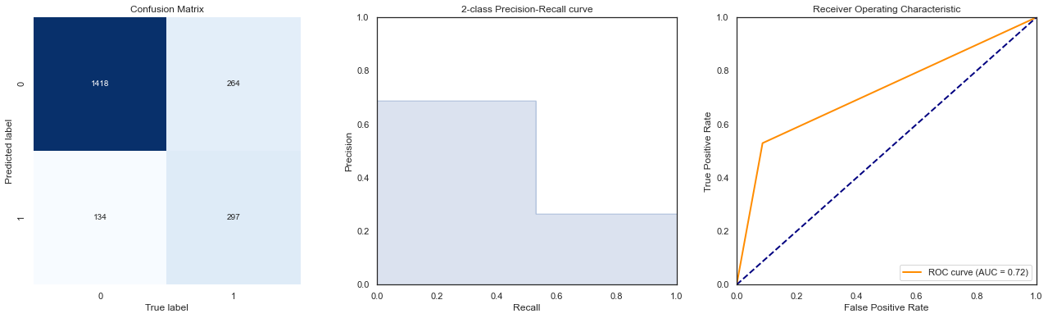
Model EVALUATION

Slide 25
Model EVALUATION

Slide 26
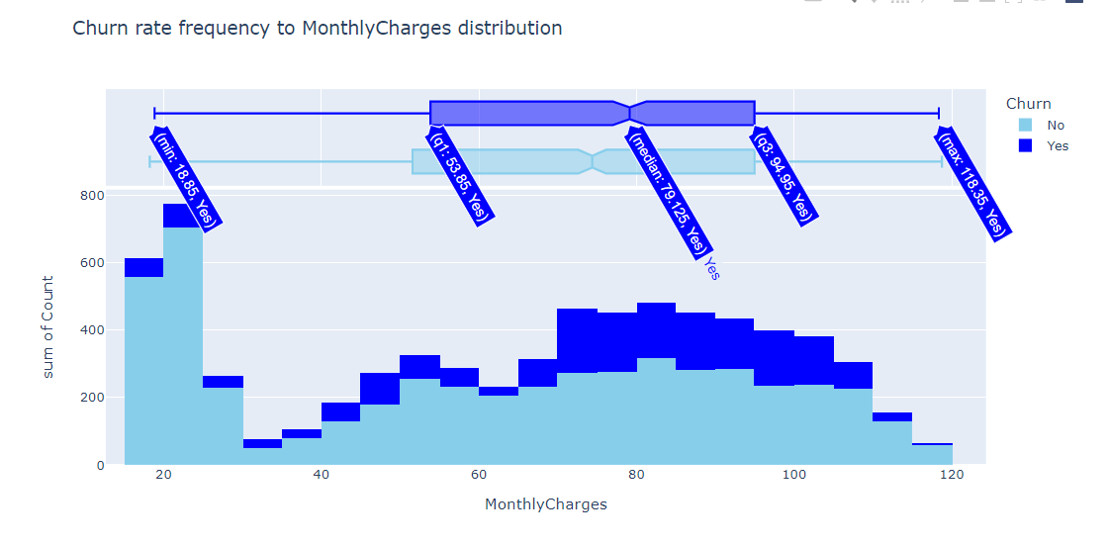
BUSINESS evaluation - sales

Slide 27
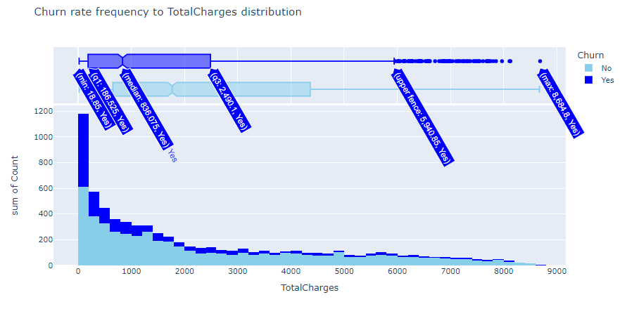
BUSINESS evaluation

Slide 28
BUSINESS evaluation- retaining rate
Monthly Charges
= $79.25
Profit at 20% Customer NOT Churn
Sales - Cost
= $ (79.25 x 294 x 20%)- (138+294)x(15.85)
=$ 4659.6- 6847.2 = - 2187.6
Campaign Cost
= $79.25 x 20% =15.85
Profit at 29.39% Customer NOT Churn
Sales - Cost
= $ (79.25 x 294 x 29.39%)- (138+294)x(15.85)
=$ 6847.2 - 6847.2 = 0
Profit at 80% Customer NOT Churn
Sales - Cost
= $ (79.25 x 294 x 80%)- (138+294)x(15.85)
=$ 18639.6- 6847.2 = 11792.4

Slide 29
BUSINESS evaluation- PROFIT FORECAST
Total Charges (Annually)
= $836
Revenue Gain
= $836 x 297 x 20%
=$ 49,658
Revenue Gain
= $836 x 297 x 50%
=$ 124,146
Revenue Gain
= $836 x 297 x 80%
= $ 248,292

Slide 30

summary
Develop model to predict customer churn.
Logistic Regression model will be deploy for production with accuracy of 81%.
Identify features which lead customer to churn.
Monthly Charges [$70 - $100]
Internet Services with Fibre Optics
Contract Month-Month
Payment Method with E-Checks
Low Add On Services
Forecast Retaining Rate for surplus profit.
Min 30% of Churn customer NOT to Churn.

Slide 31




THANK YOU
KONG WEI SHEN
+65 90799768
shen_kento555@hotmail.com
https://github.com/Kento555/Project

